Slide 1



Simplilearn
AIML Capstone - Sales Forecasting
By: Sonali Kohli

Slide 2

Background
Demand is the most important aspect of a business's ability to achieve its objectives. Many decisions in business depend on demand, like production, sales, and staff requirements. Forecasting is necessary for business at both international and domestic levels.
Problem Statement: Fresh Analytics, a data analytics company, aims to comprehend and predict the demand for various items across restaurants. The primary goal of the project is to determine the sales of items across different restaurants over the years.

Slide 3
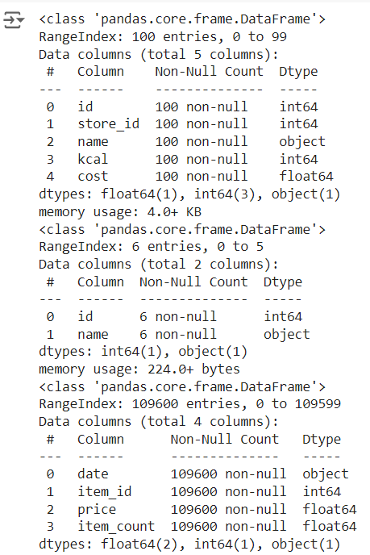
Dataset & algorithms used to forecast sales
There are 3 datasets naming Items, Restaurants and Sales which includes the given info. The dataset has been converted into proper datetime and datetimeindex format for further analysis
Machine learning Models used:
Linear Regression
Random Forest Regressor
XGBoost
Deep learning Model used:
LSTM

Slide 4
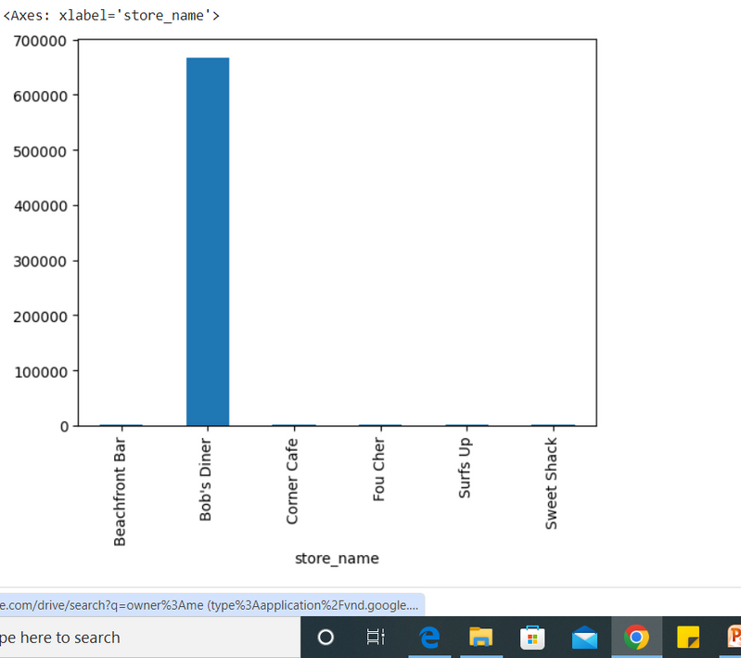
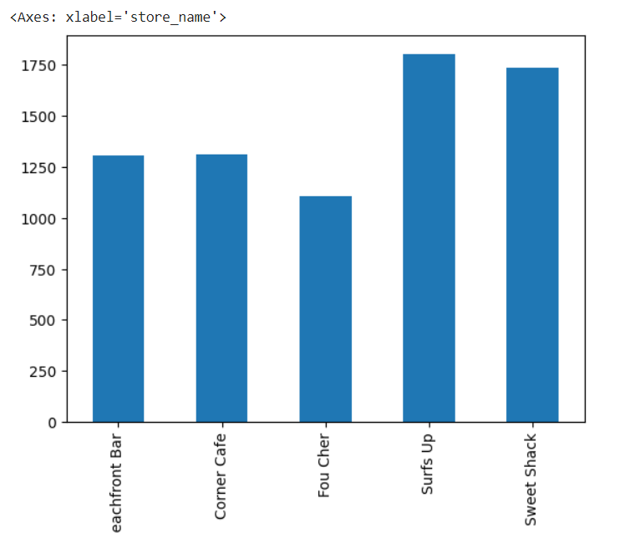
Preliminary Analysis
Merging datasets after renaming columns:
It can be seen that Bob's Diner's sales is contributing the most in overall dataset but it is also numerically at a distance from rest of the values in the dataset.
Outlier detection:
Therefore, here we are removing the data from this restaurant altogether to get a more balanced data distribution. We get a more evenly distributed data after removing Bob’s Diner’s sales.

Slide 5
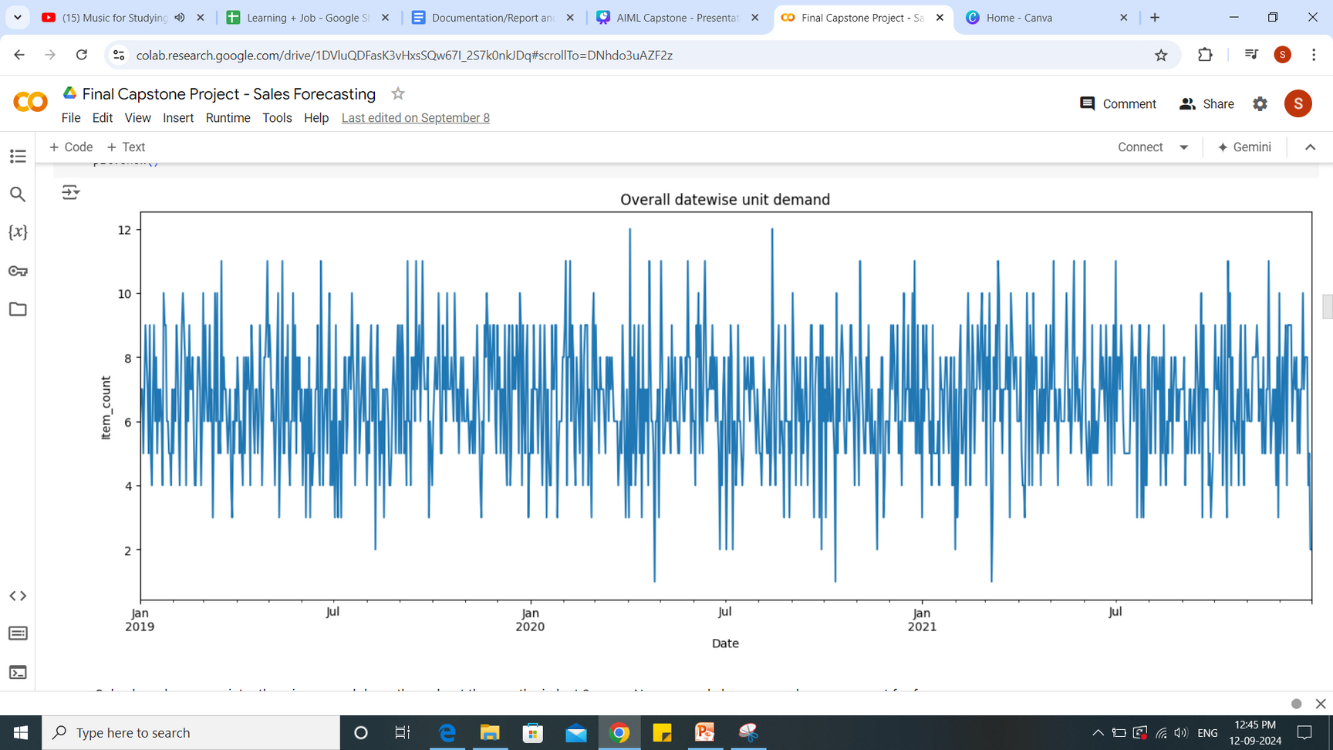
Exploratory Data Analysis
The overall date wise sales to understand the pattern:
Sales have been consistently going up and down throughout the months in last 3 years. No seasonal changes can be seen except for few spikes in March and August.

Slide 6
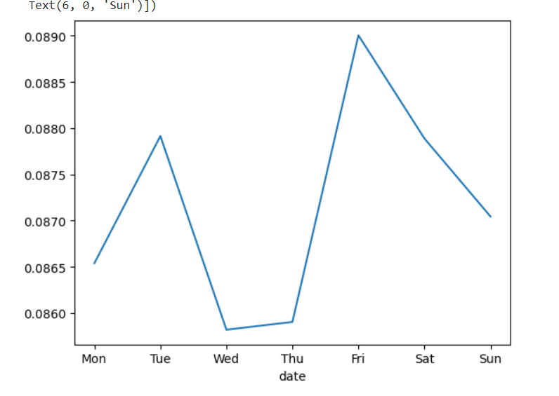
Exploratory Data Analysis
How sales fluctuate across different days of the week?
Highest average sales recorded on Tuesdays, Fridays and Saturdays whereas lower sales happen on Mondays, Wednesdays, Thursdays and Sundays.

Slide 7
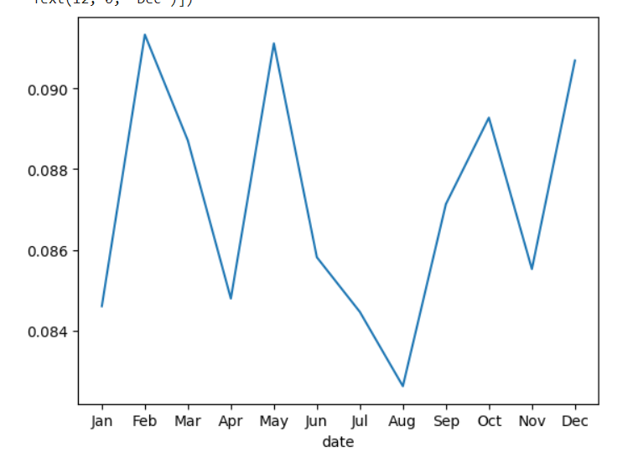
Exploratory Data Analysis
Trends in the sales data for different months of the year
Averagely sales are up and down every month with few spikes in February, May, October and December.

Slide 8
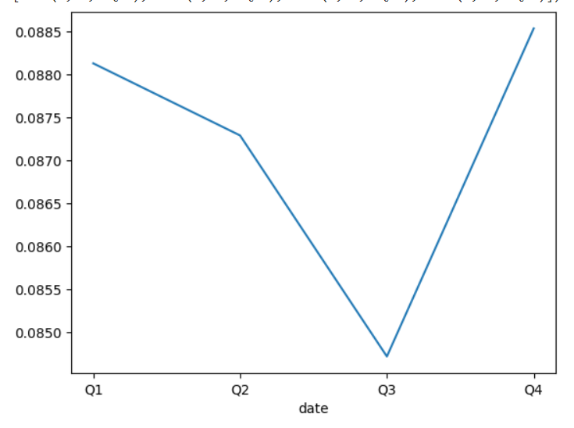
Exploratory Data Analysis
Sales distribution across different quarters averaged over the years
On an average, quarter 3 was the lowest in terms of sales, quarter 4 and 1 being doing good followed by a dropping quarter 2.
Overall, July, August and September are the worst performing months.

Slide 9
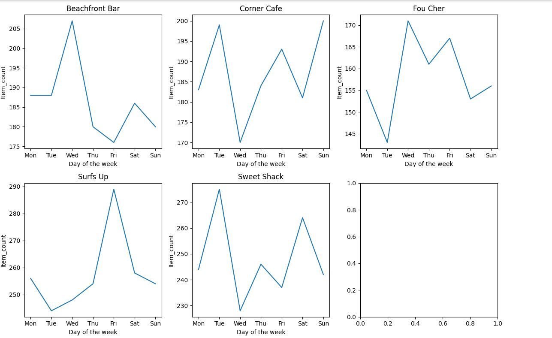
Exploratory Data Analysis
Performances of the different restaurants: Over week
Sales have increased sharply on tuesday for Corner Cafe and Sweet Shack whereas it declined heavily for Fou Cher and Surfs Up.
Similarly, on wedenesdays, the sales shoot up for Beachfront Bar, Fou Cher, whereas declined for Corner Cafe and Sweet Shack.
Thursday, Friday and Saturday were reasonably consistent for Fou Cher, whereas sales for Surfs Up and Corner cafe shooted high on friday.
On weekend, it dipped for all except for sweet shack.

Slide 10
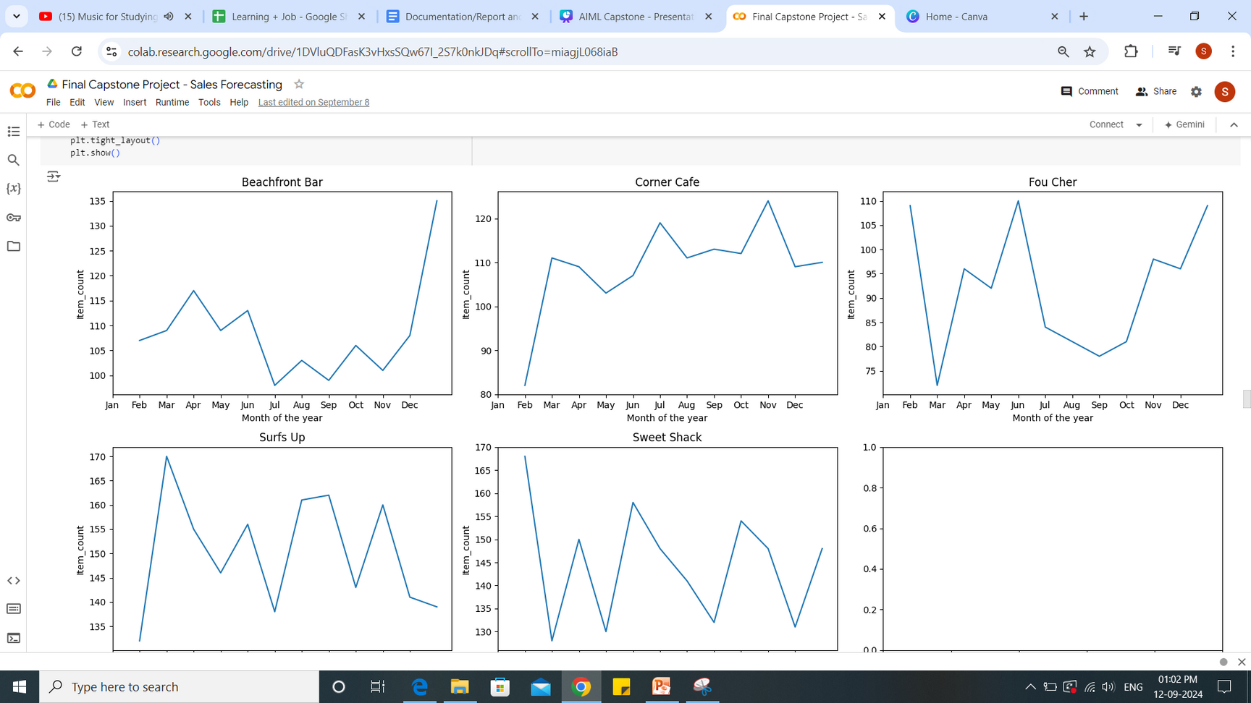
Performances of the different restaurants: Over months
No similar patterns or trends among different restaurants. Beachfront Bar's revenues have decreased consistently from beginning of the year towards the end. On the opposite, Corner Cafe's revenues have increased from the beginning of the year towards the end.
Fou Cher, Surfs up and Sweet Shack's revenues have been fluctuating all over the year.

Slide 11
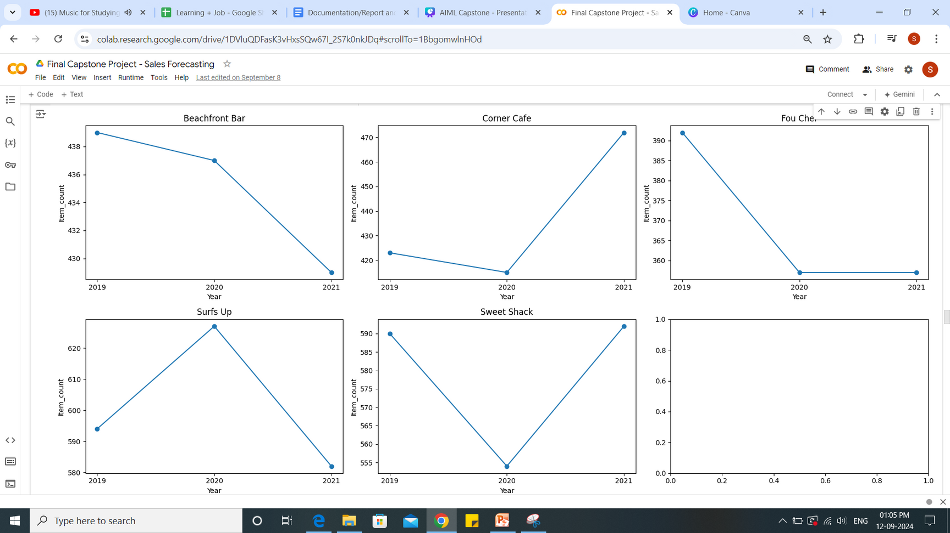
Performances of the different restaurants: Over 3 years
2019: Higher sales - Beachfront Bar, Fou Cher and Sweet Shack
2020: Higher sales - Surfs Up. Declining sales - Beachfront Bar.
2021: Higher sales - Corner Cafe and Sweet Shack
Overall - Beachfront Bar, Fou cher and Surfs Up's sales have declined.

Slide 12
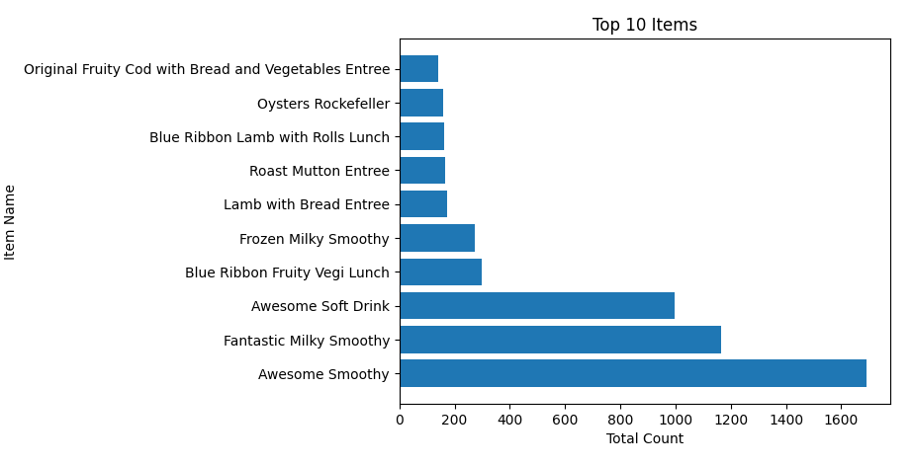
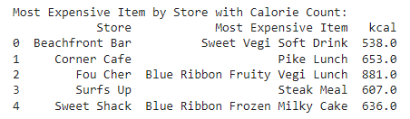
Most popular items overall by store:
Top 3 items: Awesome smoothy by Sweet Shack, Fantastic Milk Smoothy by Beachfront Bar and Awesome soft drink by Surfs Up.
Most expensive item at each restaurant and find out its calorie count:

Slide 13

Forecasting using machine learning algorithms
Build and compare linear regression, random forest, and XGBoost models for predictions

Slide 14

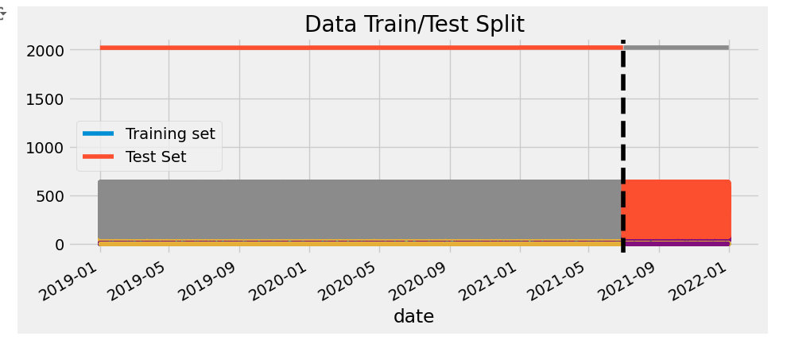
Split the data into train and test
After initial processing of data (which included label encoding the categorical variables), the last six month’s data was split into test dataset.
Thereafter new features are created to set feature and target variables.

Slide 15
RMSE (Root mean squared error) of different ML models
Linear Regression
0.17328234396391892
Random Forest Regressor
0.02827225941048775
Lowest error
XGBoost
0.6572289962381116

Slide 16
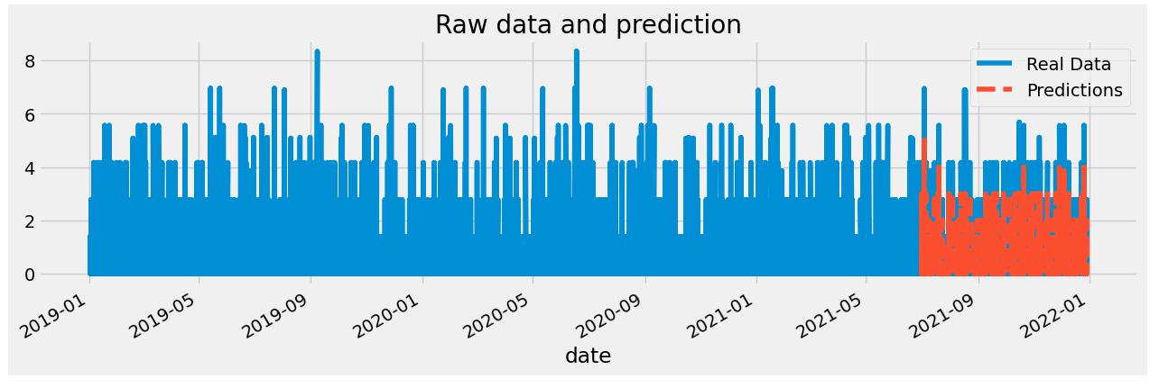
Using Random forest regressor to predict values for next year

Slide 17
Forecasting using deep learning algorithms
Long short-term memory (LSTM) Model

Slide 18
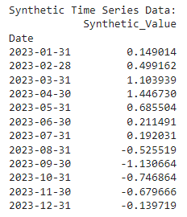
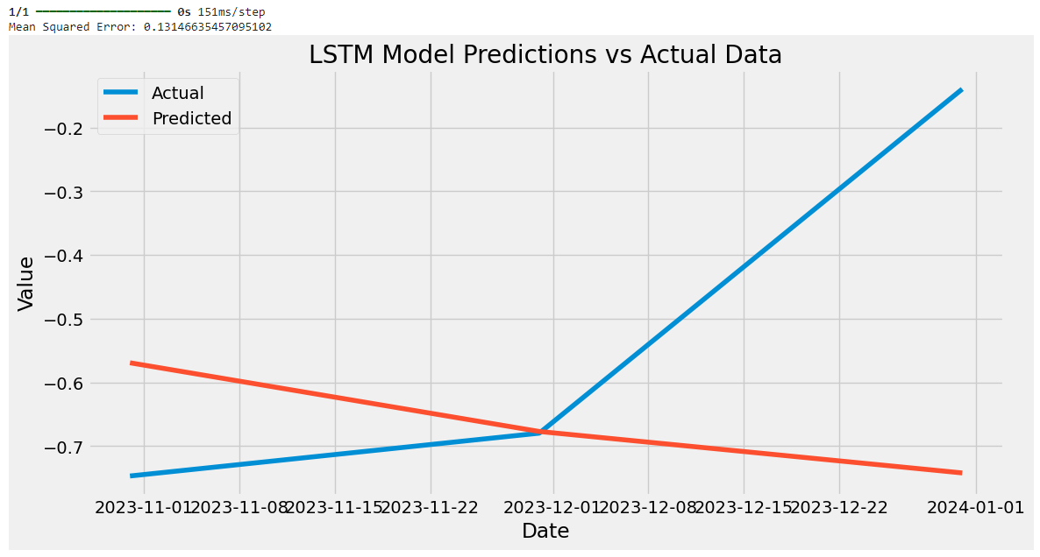
Generating synthetic data and building LSTM on the same

Slide 19
Calculating the mean absolute percentage error (MAPE)
Mean Absolute Percentage Error (MAPE)
8.83%
Mean absolute percentage error is a relative error measure that uses absolute values to keep the positive and negative errors from canceling one another out and uses relative errors to enable you to compare forecast accuracy between time-series models.
Lower values of MAPE indicate higher accuracy, while higher values indicate lower accuracy. A MAPE of 8.83% implies that, on average, the predictions are 8-9% off from the actual values.

Slide 20
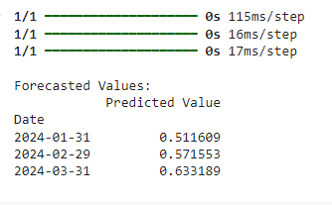
Developed another model using the entire series for training, and used it to forecast for the next three months

Slide 21
Thank You!

